Slide 1
David S. Ingalls Rink
Amy Huan | Lighting Schematic Design Presentation | 11.10.2013

Slide 2
|General Building Data
Building name: David S. Ingalls Rink
Location: New Haven, CT
Building Occupant: Yale University
Architect: Eero Saarinen
Date Constructed: 1953 – 1959 (renovation 2008-2010)
Building Footprint: 47,983 sf
Total gsf: 61,646 sf
Total Levels: 2
|Project Team
Architect: Kevin Roche John Dinkeloo and Associates, LLC
Lighting Consultant: Atelier Ten Consulting Designers

Slide 3
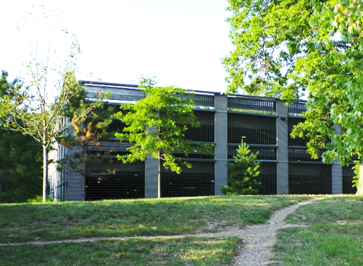
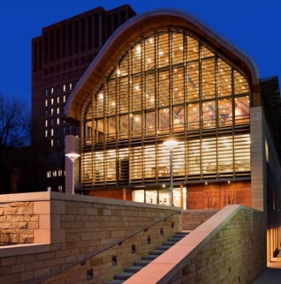
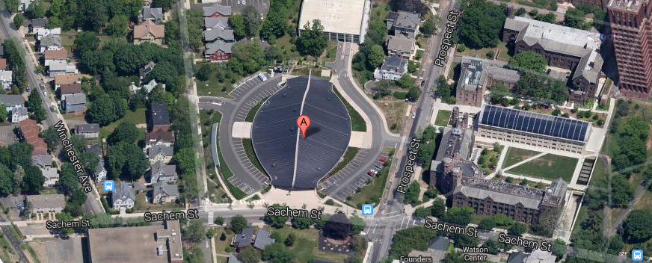
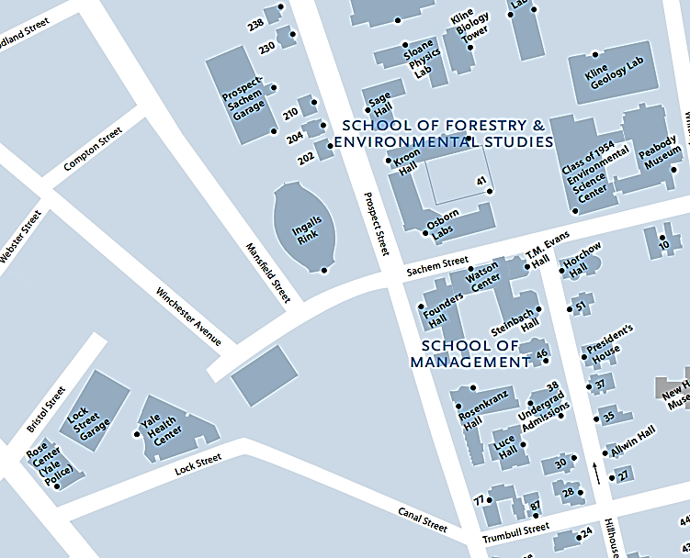
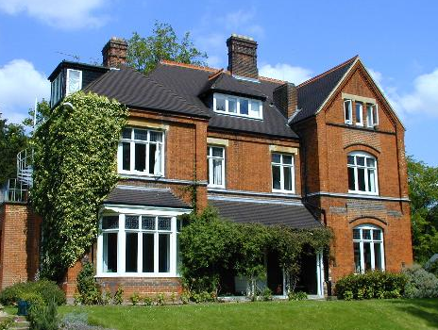
School of Forestry & Environmental Studies
|Building Location
N
Prospect Sachem Garage
Student Housing
Under Construction
Residential Houses
Notes:
Yale North Campus

Slide 4
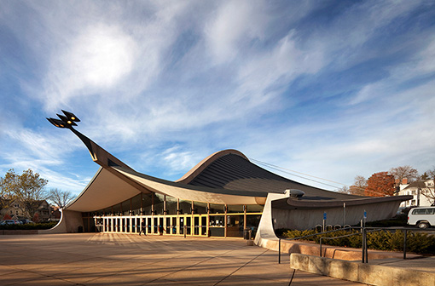
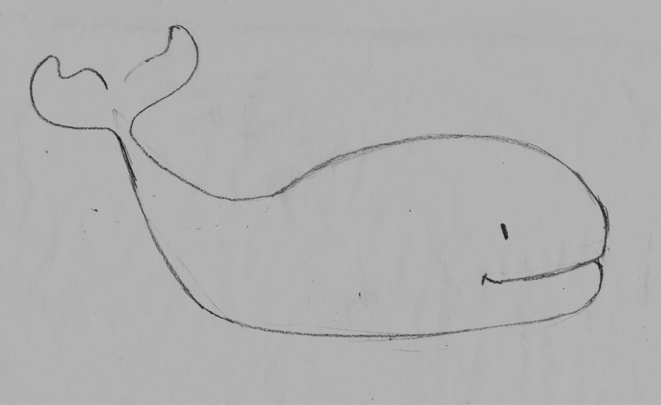
Habitation
Yale “Whale”

Slide 5
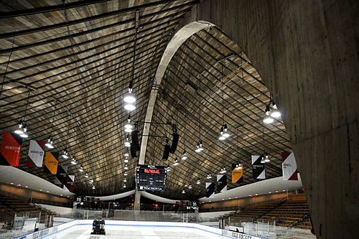
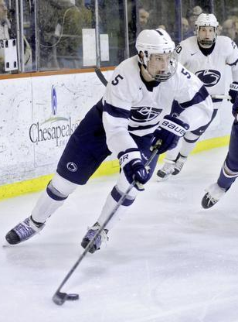
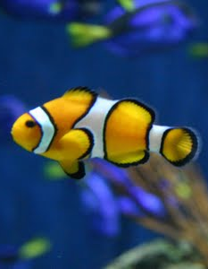
Habitation

Slide 6
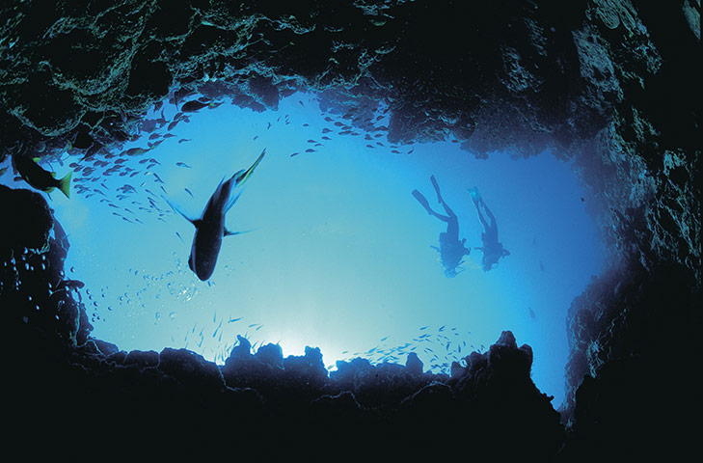
Habitation

Slide 7
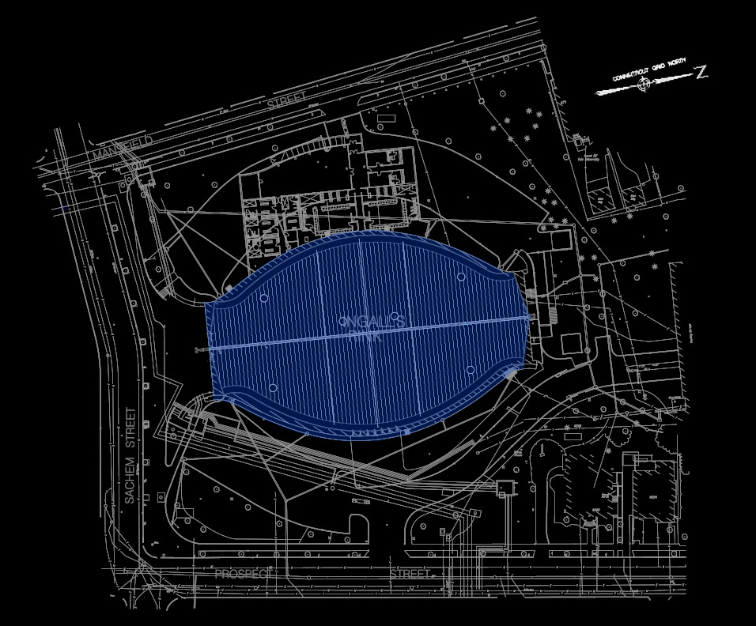
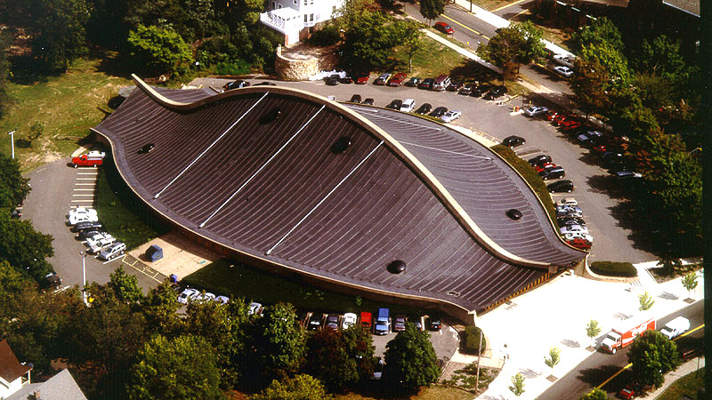
|BUILDING EXTERIOR
| Design Criteria
Enhance the architecture + environment
Respect history
Establish nighttime identity
3 schematic Design solution
Notes:
Building Exterior
Recognized as the “best design” across all of America by NY Times
Venerable history and reputation as a hollowed spot
Function / structure / being part of the time
Relation to neighborhood
Mass and scale
Dramatic structural elements
Enhance the surrounding environment
Respect the historically significant architecure
Integrate with existing landscape such as tree and street poles

Slide 8
Jump
Dive
Swim

Slide 9
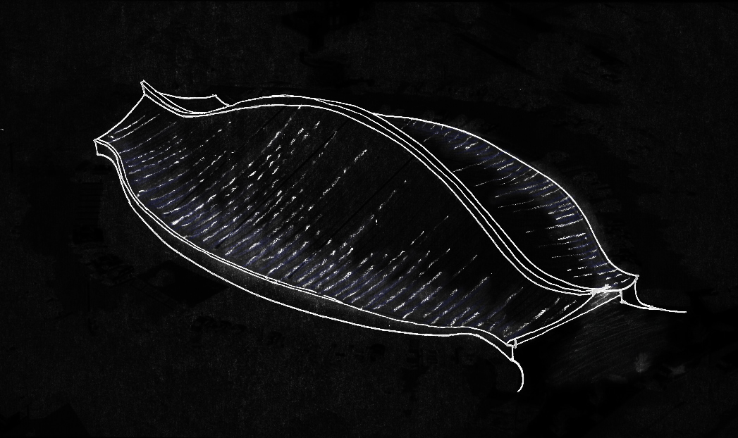
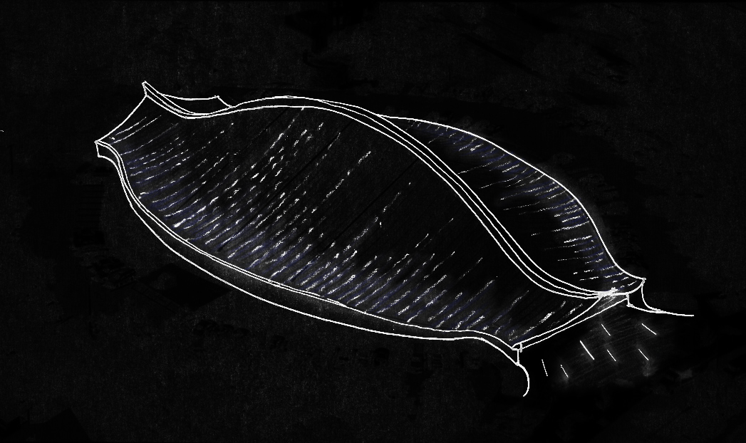
|BUILDING EXTERIOR
|Schematic 1: Jump
motion + splash
- LED node with programmed sequence
- in-ground uplights
- linear grazer for exterior walls
- Existing lighting sculpture with “dragon eye”

Slide 10
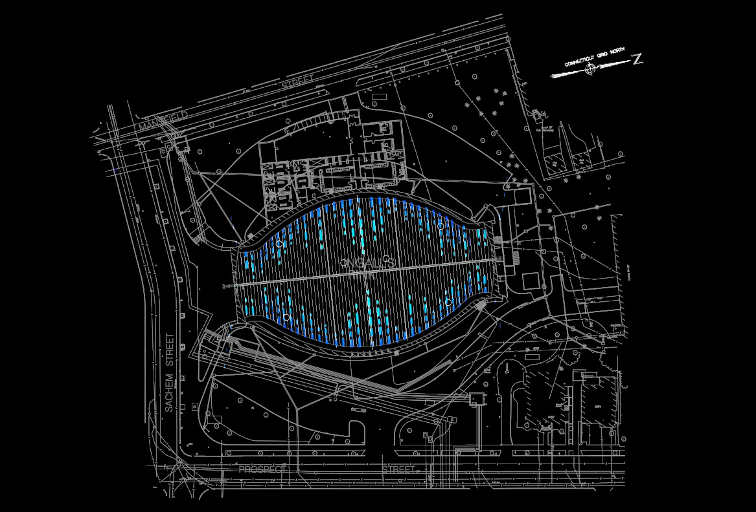
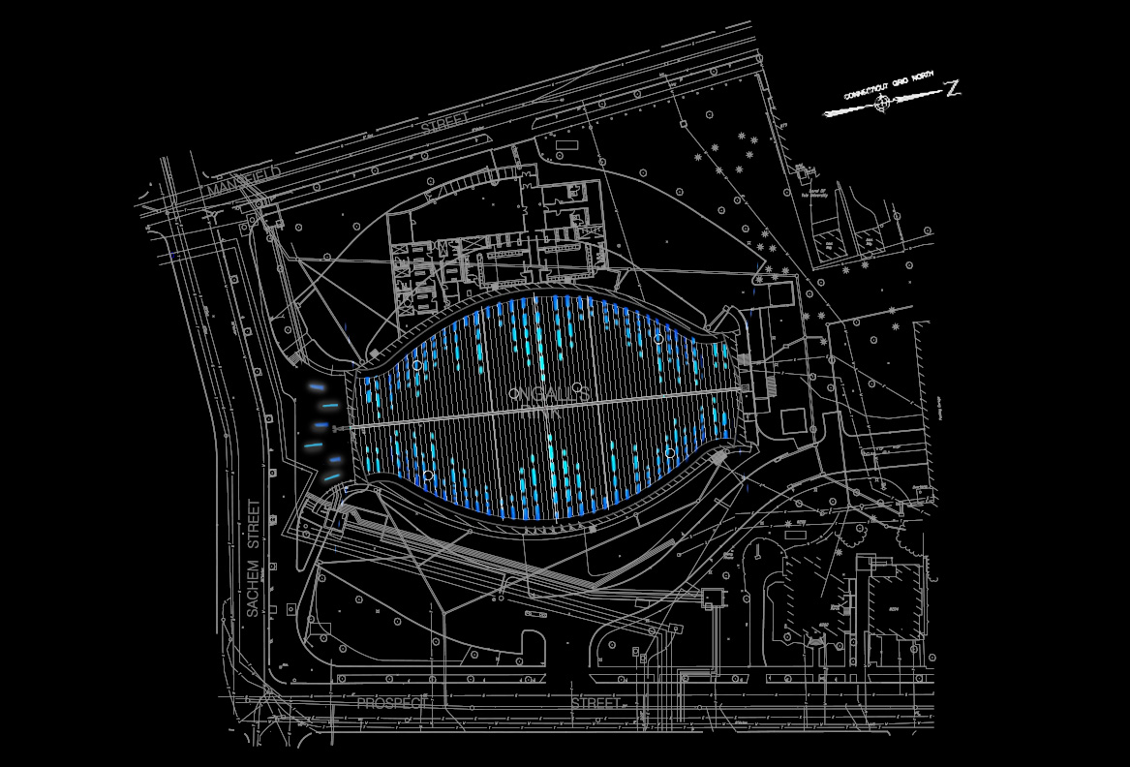
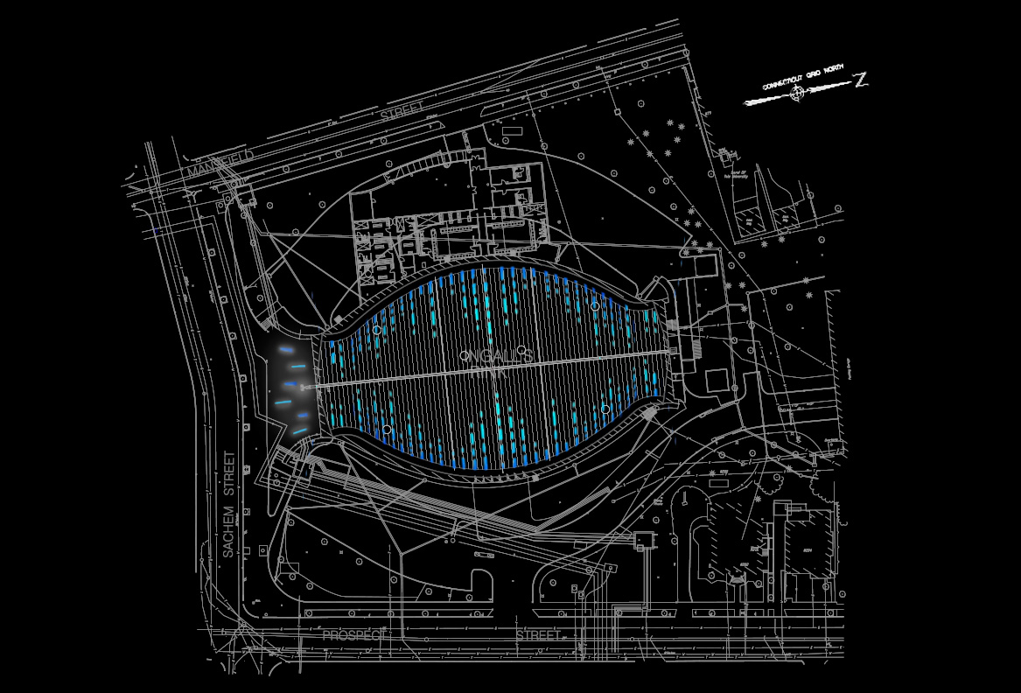
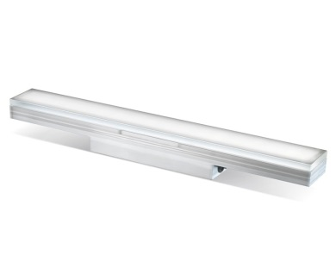
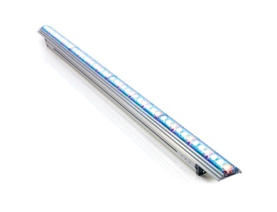
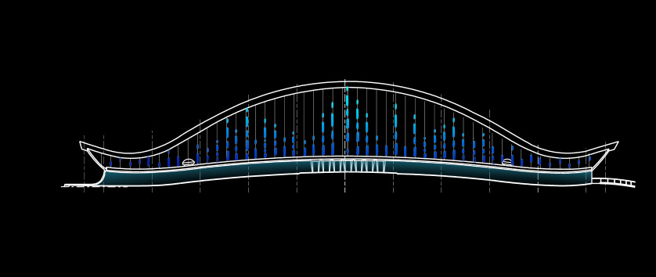
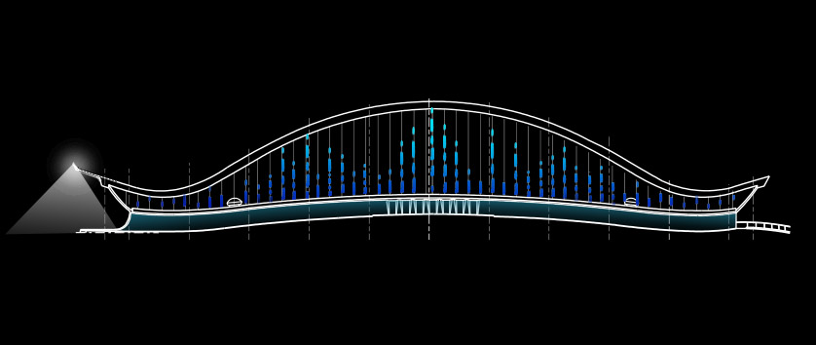
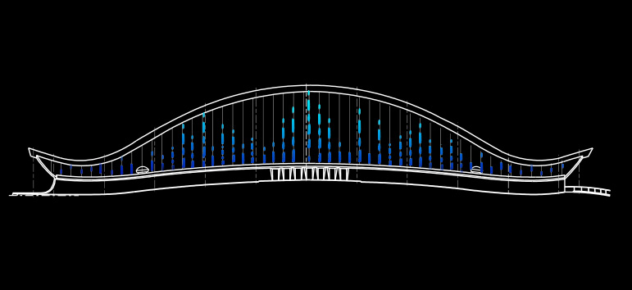
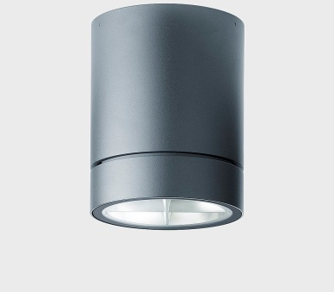
|BUILDING EXTERIOR

Slide 11
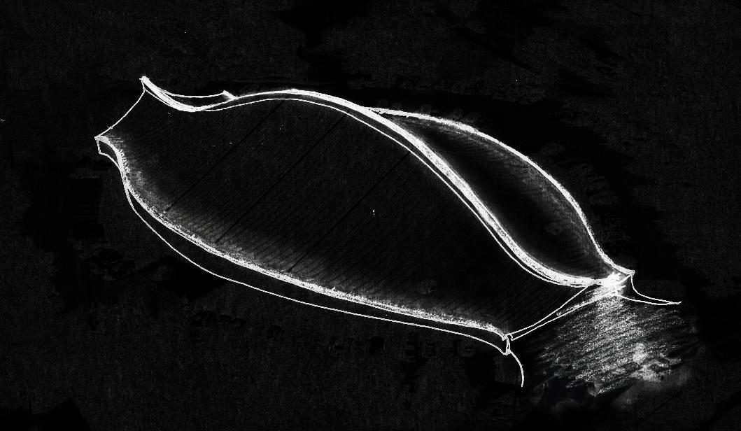
|BUILDING EXTERIOR
|Schematic 2: Dive
curve + tail fins
- Linear uplight on the spine
- Linear grazer on roof edge
- Existing lighting sculpture with “dragon eye”
(@higher level)

Slide 12
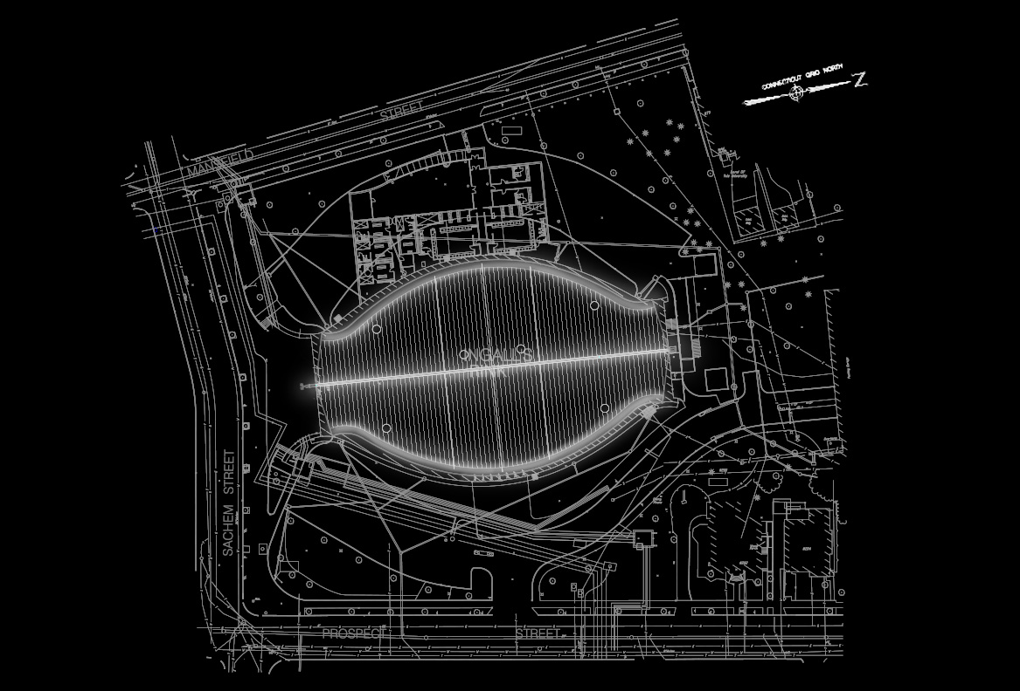
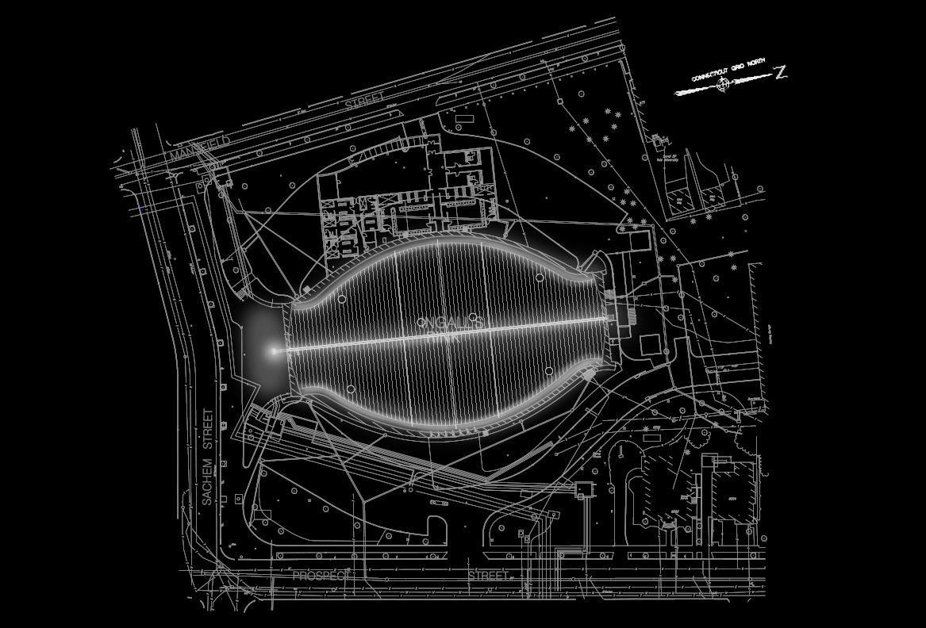
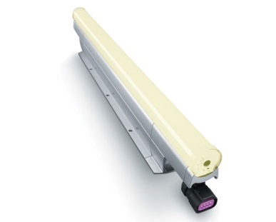
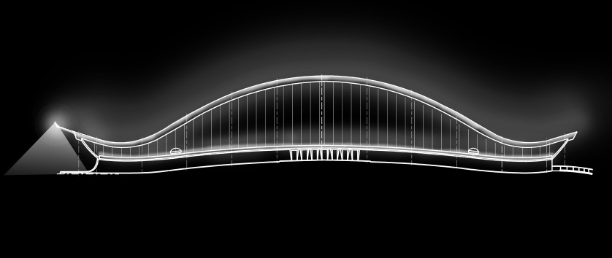
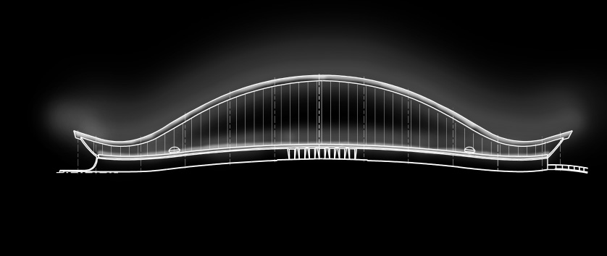
|BUILDING EXTERIOR

Slide 13
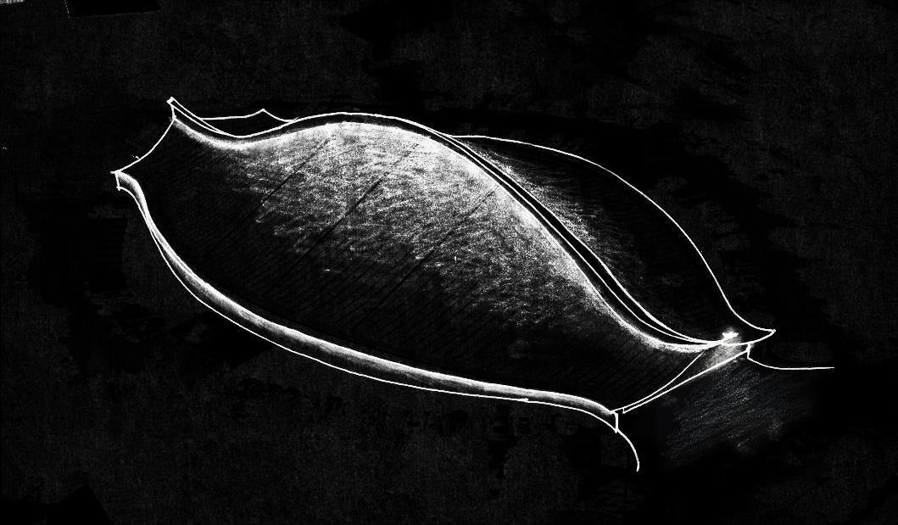
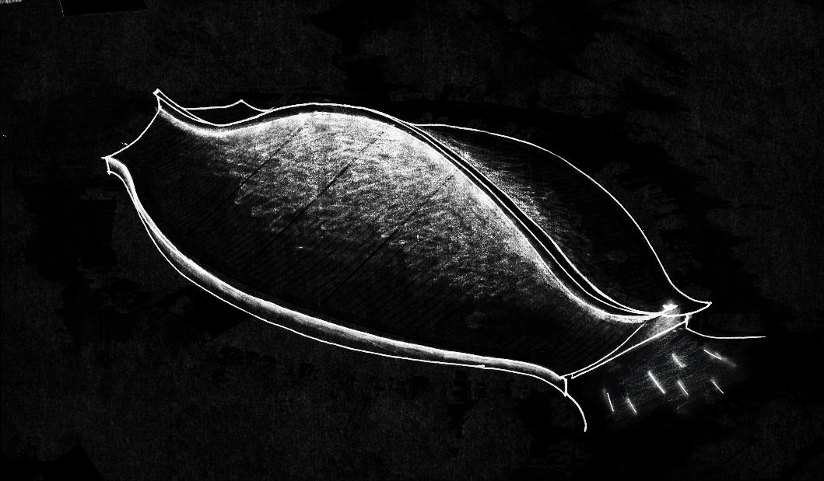
|BUILDING EXTERIOR
|Schematic 3: Swim
highlight + shimmer
- Linear grazer from mid-spine
- Linear grazer for exterior walls
- in-ground uplights
- Existing lighting sculpture with “dragon eye”
Notes:
Linear grazer for exterior walls: floating effect

Slide 14
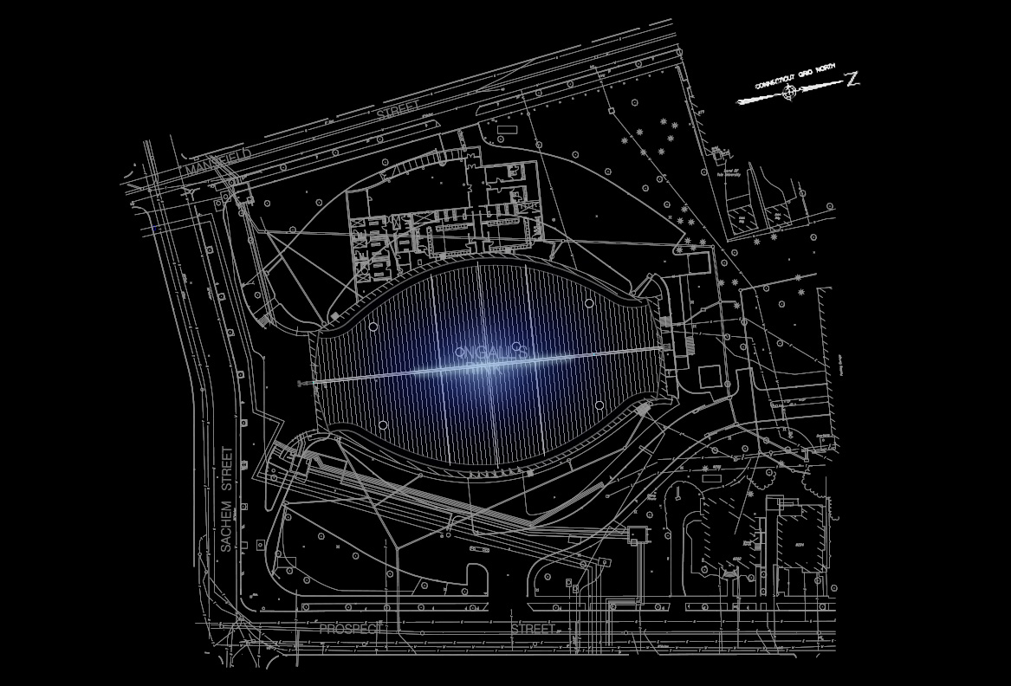
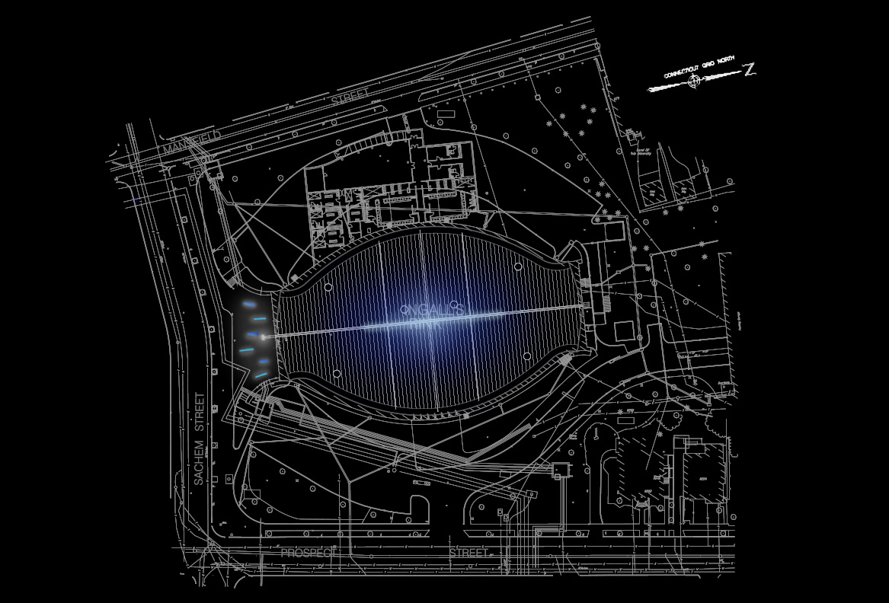
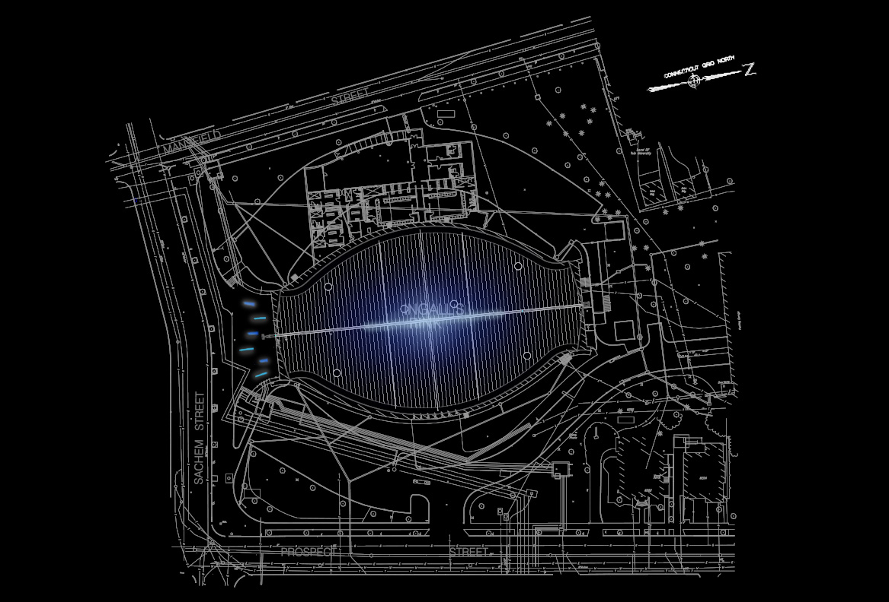
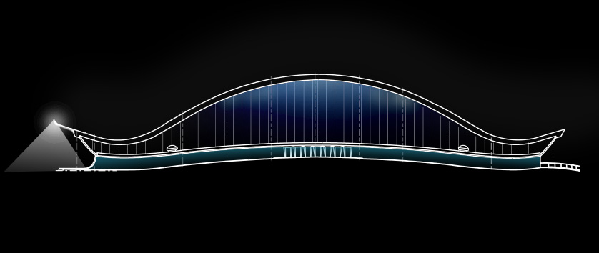
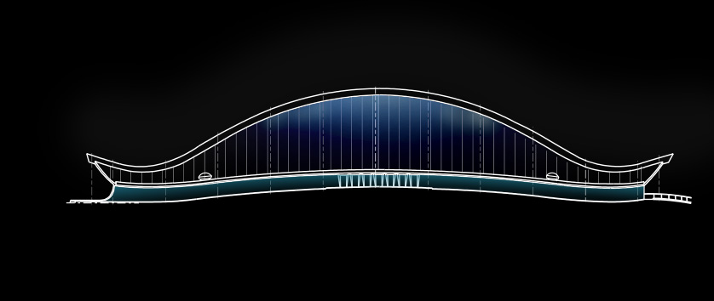
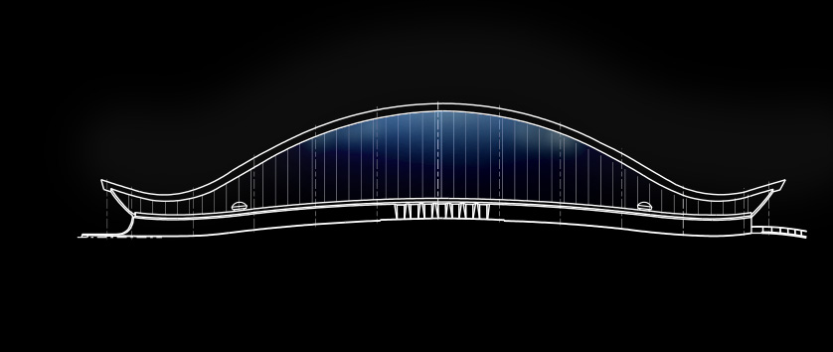
|BUILDING EXTERIOR

Slide 15
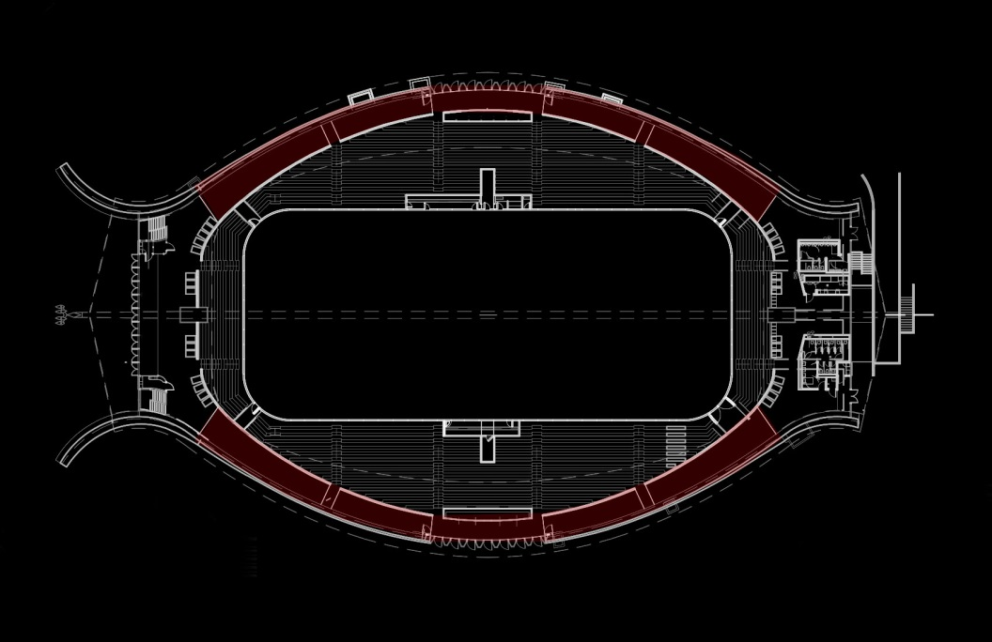
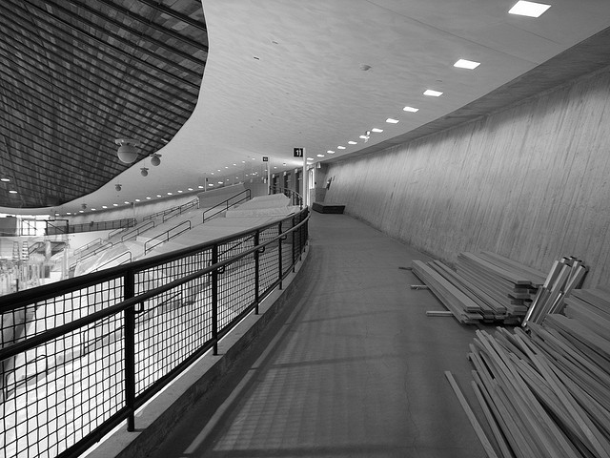
|Circulation
| Design Criteria
Lead direction
Decrease distraction
Reduce glare at pressbox area
Accent wall texture

Slide 16
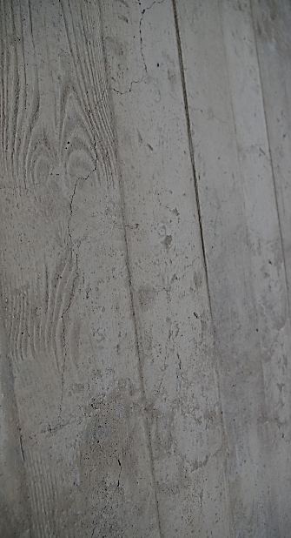
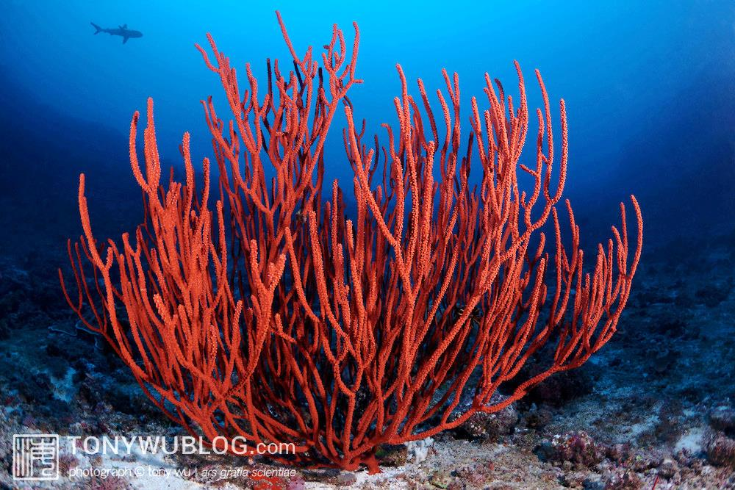
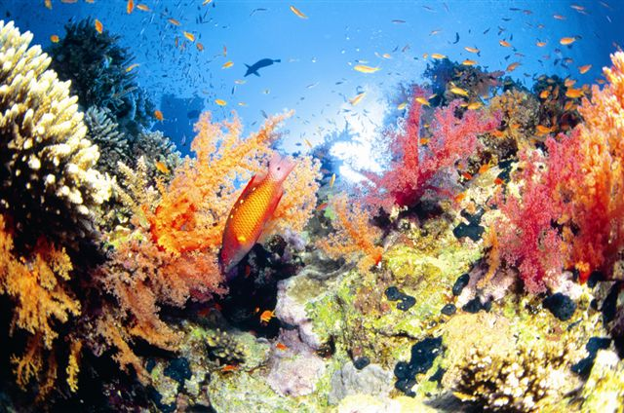
|Circulation
Coral Reef

Slide 17
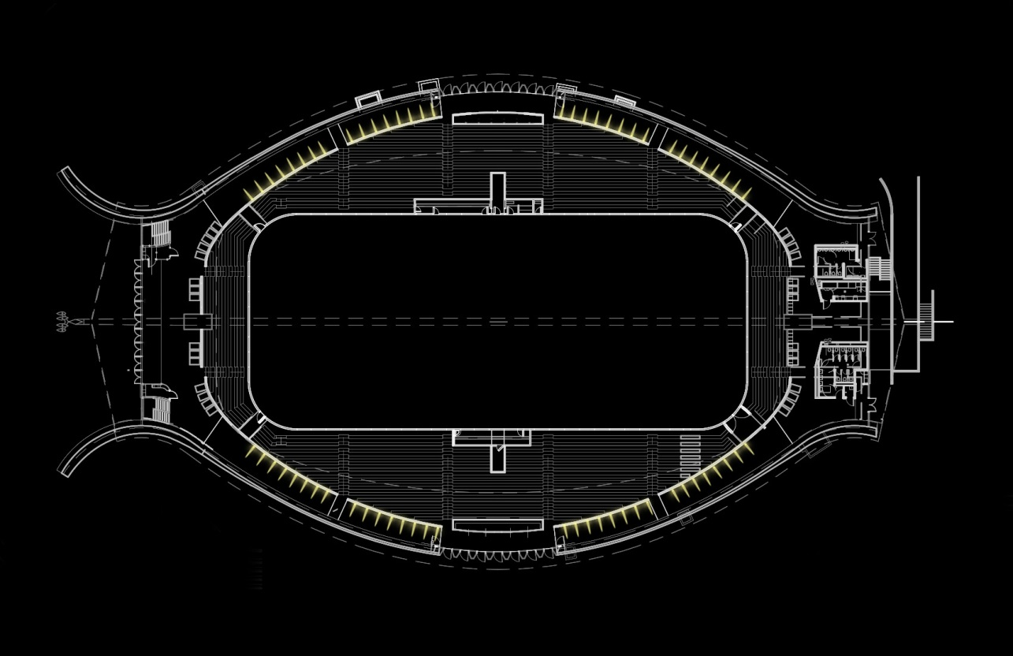
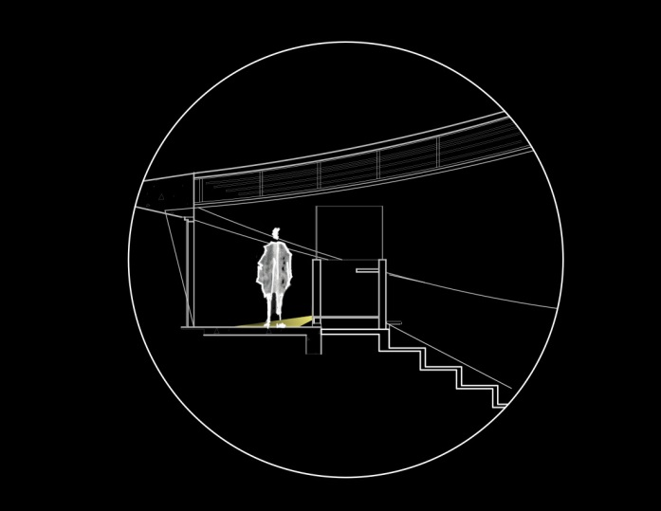
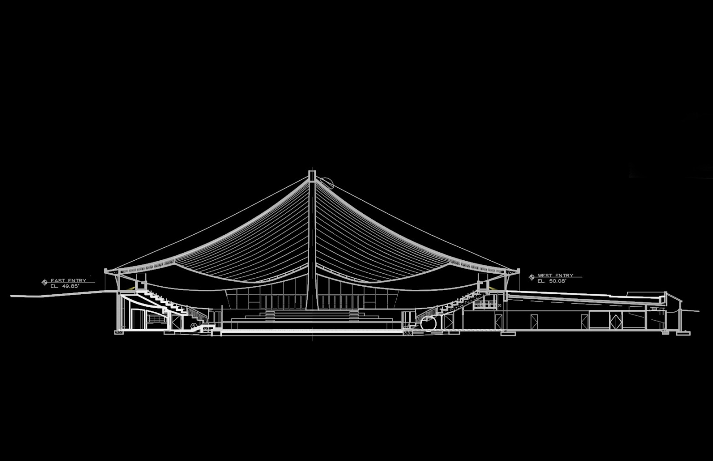
|Circulation

Slide 18
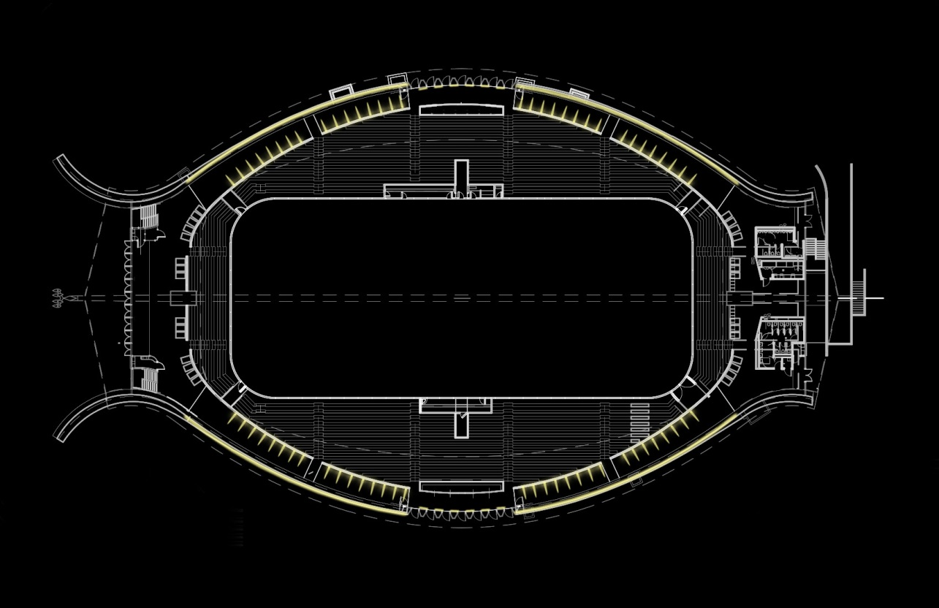
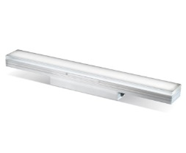
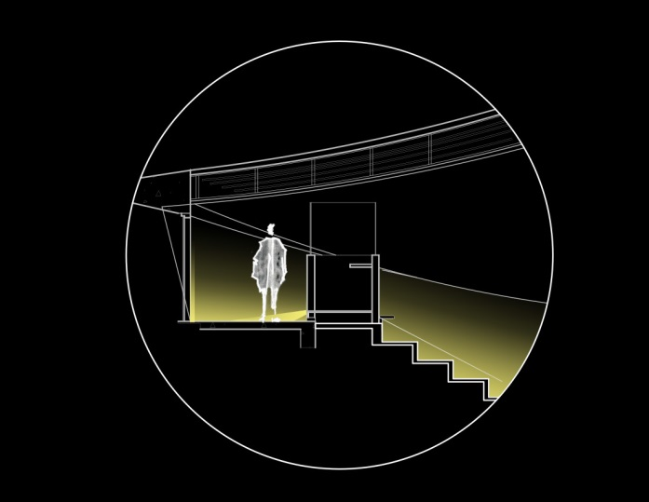
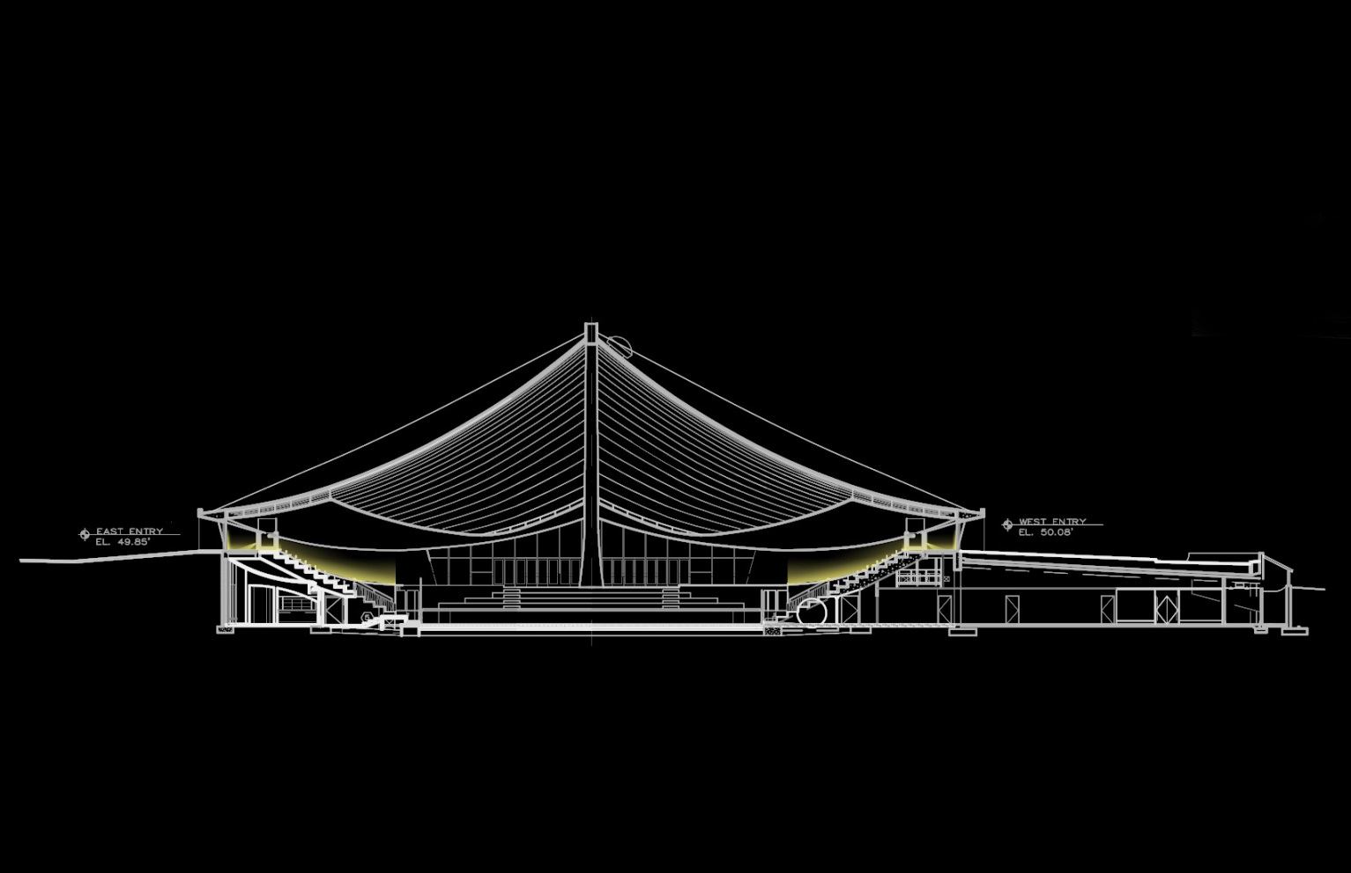
|Circulation

Slide 19
|Circulation

Slide 20
|Circulation

Slide 21
|Rink
| Design Criteria
Promote cheerfulness
Avoid glare
Enhance spatial appearance
Uniformity for sports function
Expressive for figure skating/recreational function
Efficiency + Sustainability

Slide 22
|Rink
Ocean

Slide 23
|RINK
|Ocean: figure/recreation
pattern + uniformity
- Linear grazer to accentuate the ceiling
- Use of shadow to expand the dimension
- Pendant downlight to provide uniform distribution on the ice

Slide 24
|RINK

Slide 25
|RINK

Slide 26
|RINK

Slide 27
|RINK

Slide 28
|RINK
|Ocean: Performance/Recreational
pattern + highlight
- Linear grazer to accentuate the ceiling
- Use of shadow to expand the dimension
- Spotlight
- gobo

Slide 29
|RINK

Slide 30
|RINK

Slide 31
|Schley Clubroom
| Design Criteria
Provide adequate light level and desirable highlights for art display
Create a comforting atmosphere
Enlarge the space
Private psychological impression

Slide 32
|Schley Clubroom
Deep Ocean

Slide 33
|Schley Clubroom
|Schley Clubroom: Deep Ocean
highlight + shadow
- Wall mounted fixture with up/down distribution to highlight the artworks
- Ceiling grazer on lower ceiling side to direct eyesight upwards
- Linear grazer between wood panels
- Single downlight to provide workplane luminance

Slide 34
|Schley Clubroom

Slide 35
|Schley Clubroom

Slide 36
|Schley Clubroom

Slide 37
|Schley Clubroom

Slide 38
|Schley Clubroom

Slide 39
Notes:
Building Exterior
Recognized as the “best design” across all of America by NY Times
Venerable history and reputation as a hollowed spot
Function / structure / being part of the time
Relation to neighborhood
Mass and scale
Dramatic structural elements
Enhance the surrounding environment
Respect the historically significant architecure
Integrate with existing landscape such as tree and street poles

